Slide 1
SIEM Day 2
Cybersecurity
Splunk Searches
SIEM Day 2
‹#›

Slide 2

Learning Objectives
By the end of today’s lesson, you will be able to:
1
Explore and select Splunk add-ons and apps based on project needs.
2
Upload logs into a Splunk repository.
Write complex Splunk Processing Language (SPL) queries
to analyze specific security situations.
3

Slide 4
Before we introduce Splunk and its capabilities, let’s review the concepts covered in the last lesson:
1
Organizations use continuous monitoring to monitor risks to the confidentiality, integrity, and availability of their technical assets.
2
Organizations use logs that contain log entries to monitor against these risks.
3
Organizations aggregate, parse, and normalize multiple logs so that they can be analyzed together.
4
Organizations correlate these logs with correlation rules to alert when
a security event or suspicious activity is detected.
5
SIEM software is a security tool that can assist with all of the above processes.

Slide 5

We also learned about the many
SIEM vendors available, each with different features, strengths, and weaknesses.
Notes:
shutterstock_1249231492

Slide 6
In the Next Two Modules…
… we will:
1
Focus on one of the most popular SIEM vendors: Splunk.
2
Learn about Splunk and its features.
3
Complete hands-on activities within Splunk that mirror the actions
that security professionals perform every day.

Slide 7

Splunk Capabilities

Slide 8

Splunk is the vendor name of a big data software solution, and the SIEM tool is just one of the thousands of features Splunk provides.

Slide 9
Splunk Capabilities
Splunk is…
Splunk can…
Splunk has…
A software tool that searches, analyzes, and monitors big data with an easy-to-use interface.
Capture large amounts of incoming data, which can be used to create visualizations, reports, and alerts.
A base product that is designed to conduct basic tasks such as searching and reporting.

Slide 10
Splunk Capabilities
This week, we’re focusing on Splunk’s benefits to the InfoSec industry.
However, Splunk is useful for a variety of industries, such as:
Finance
Utilities
Healthcare

Slide 11

Finance
Financial organizations
can use Splunk to analyze
mortgage rates and
determine future
rate changes.
‹#›
Notes:
shutterstock_376748761

Slide 12

Utilities
Gas companies can
use Splunk to monitor customer use levels.
‹#›
Notes:
shutterstock_1052081066

Slide 13

Healthcare
Medical researchers can
use Splunk to create
reports and metrics for analyzing the success
of medical trials.
‹#›
Notes:
shutterstock_1027449325

Slide 14

Apps, Add-Ons, and Suites
Splunk can be used for these industry-specific tasks by adding the following to the base product: Splunk apps, Splunk add-ons, and Splunk suites.
Source: splunk.com

Slide 15
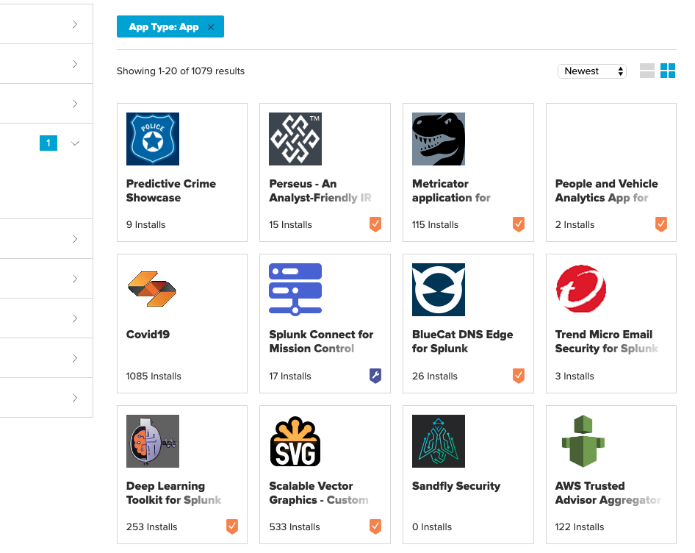
These are applications that users can add to their Splunk base product that have custom searches
and features, and
their own interfaces.
Splunk Apps
(Source)
Source: splunkbase.splunk.com

Slide 16
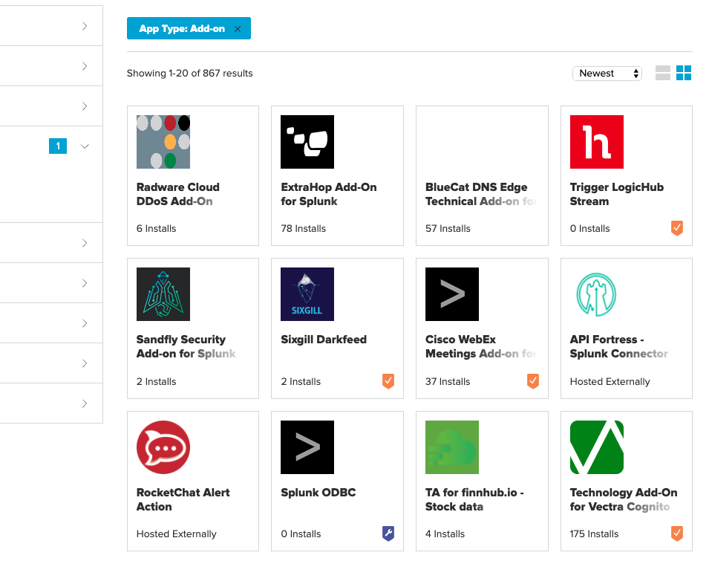
These are smaller
Splunk components
that provide additional functionality without
their own interfaces.
Splunk Add-Ons
Source: splunkbase.splunk.com
‹#›

Slide 17
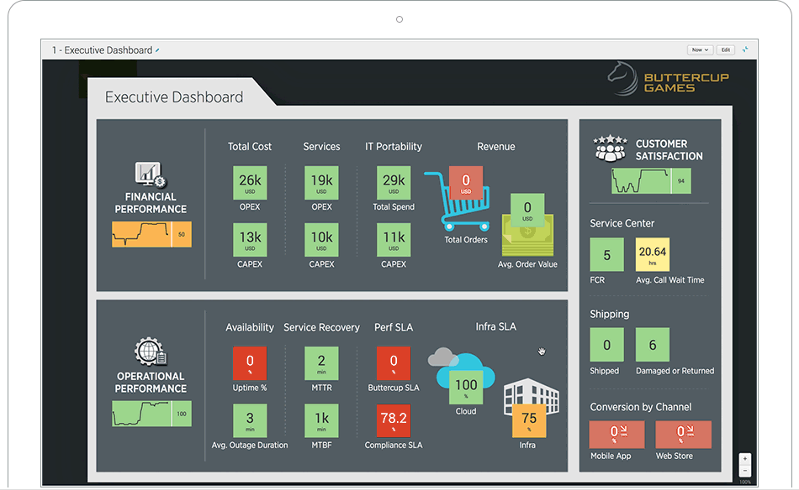
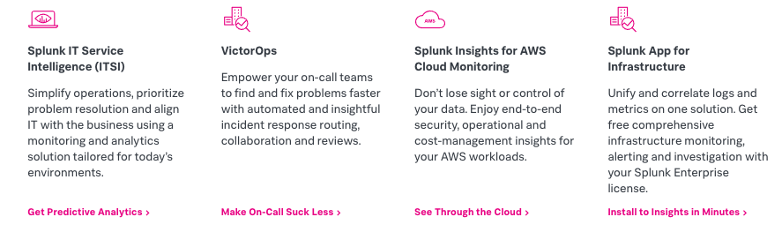

These are collections
of Splunk apps with a
single focus, such as an industry or technology.
Splunk Suites
We will not review Splunk
suites in this lesson.
Source: splunk.com

Slide 18
Apps, Add-Ons, and Suites
Splunk has so many of these apps and add-ons that they are broken up by type.
Technology
Vendor
Industry
For example, there are apps and add-ons specific
to cloud servers.
For example, there are apps and add-ons specific
to the security vendor Rapid7.
For example, there are apps and add-ons specific
to manufacturing organizations.

Slide 19
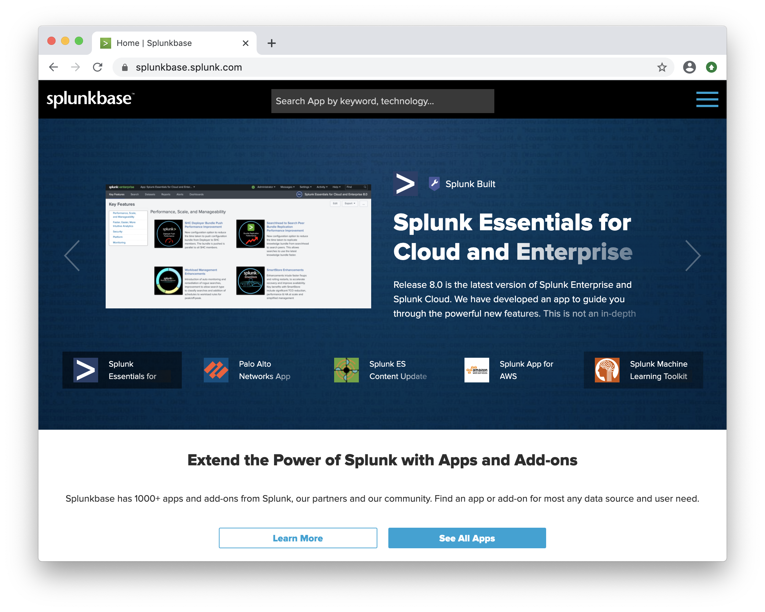
Splunk Apps and Add-Ons
We will explore various Splunk apps and add-ons with the following scenario:
Your manager has notified
you that the organization has purchased a web application filter from the vendor F5.
Your manager would like you
to find the appropriate Splunk app to assist with monitoring this product.
Source: splunkbase.splunk.com

Slide 20
Splunk apps and add-ons
‹#›

Slide 21
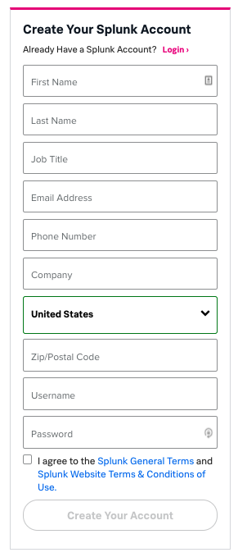
Splunk Account
Do not sign up for a Splunk account at this time.
There is a 7-day trial window that
we will start next week so that we
have access to Splunk for as long
as the curriculum requires it.

Slide 22
‹#›

Slide 23
Splunk features
In this activity, you will analyze Splunk apps and add-ons
to determine which will work with your security products.
15 minutes

Slide 24
‹#›

Slide 25
‹#›

Slide 26

Tour of Splunk

Slide 27
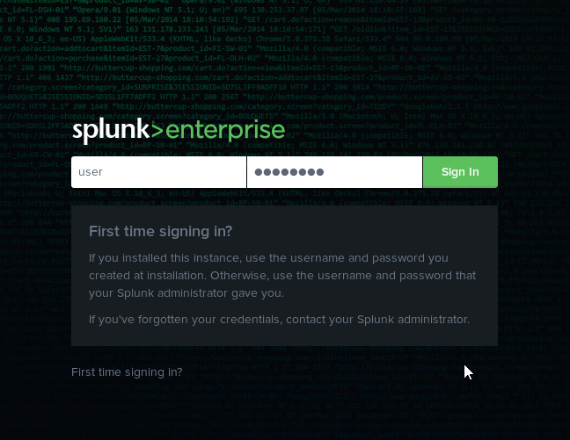
Tour of Splunk
The best way to learn how to use the Splunk product is to dive right in and start using the application.
Notes:
shutterstock_1148076149

Slide 28
Tour of Splunk
In the following walk-through, we’ll explore the Splunk:
Setup
Interface
Features

Slide 29
Splunk tour
‹#›

Slide 30
‹#›

Slide 31

Adding Data into Splunk

Slide 32
Before we add data,
it is important to understand Splunk’s architecture and how it handles incoming data.

Slide 33
Splunk Architecture Basics
Splunk architecture contains two primary components:
The Indexer
The Search Head
Splunk transforms incoming data into events.
Splunk adds these events into repositories called indexes.
Indexers are used to add events
to indexes and search through
the data.
The search head is Splunk’s GUI that we use to conduct searches.
It manages search requests
to the indexer and provides the
search results back to the user.

Slide 34

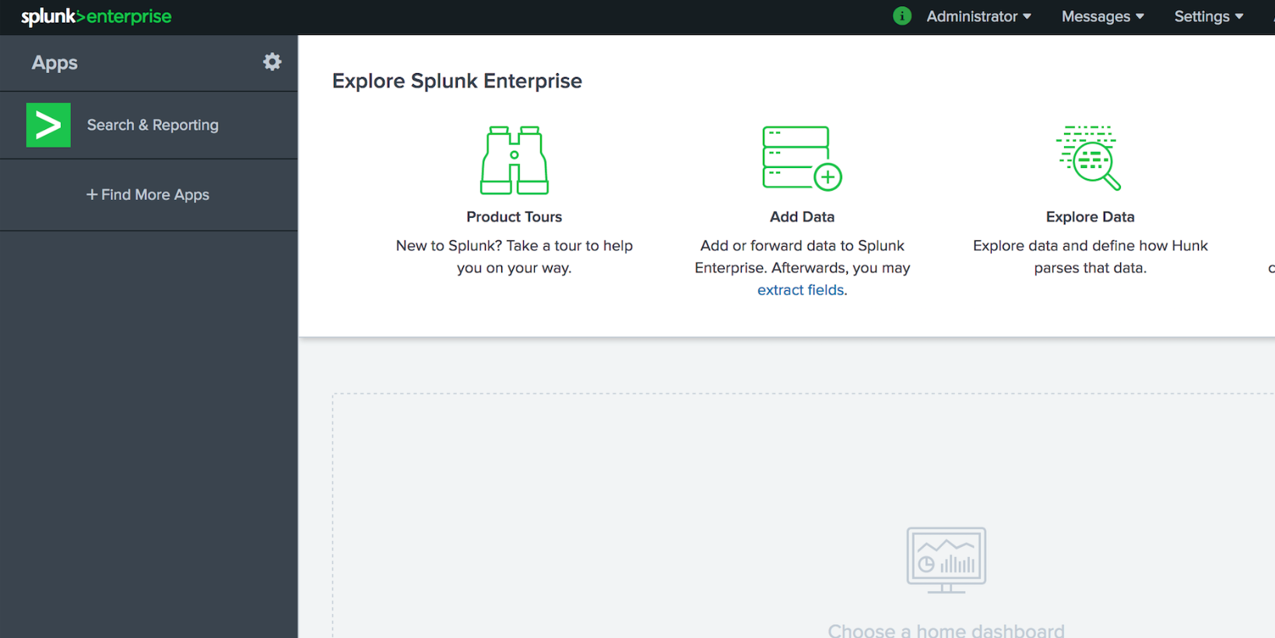
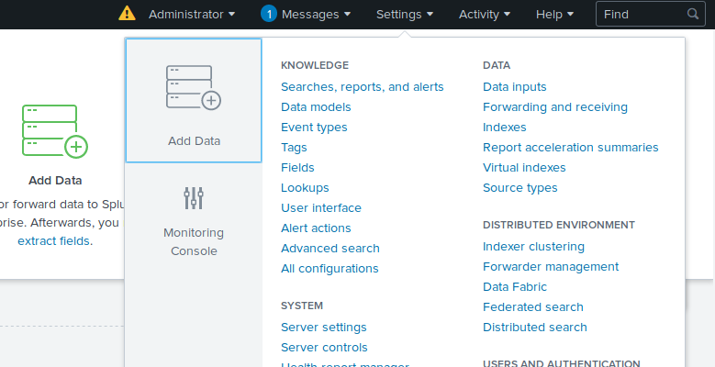
Splunk Data Addition Methods
To add data to Splunk on the Add Data page, we use one of the following paths:
From the Welcome Page
From the Search & Reporting App
Go to “Explore Splunk Enterprise” and select “Add Data.”
Select “Settings” and then “Add Data.”

Slide 35
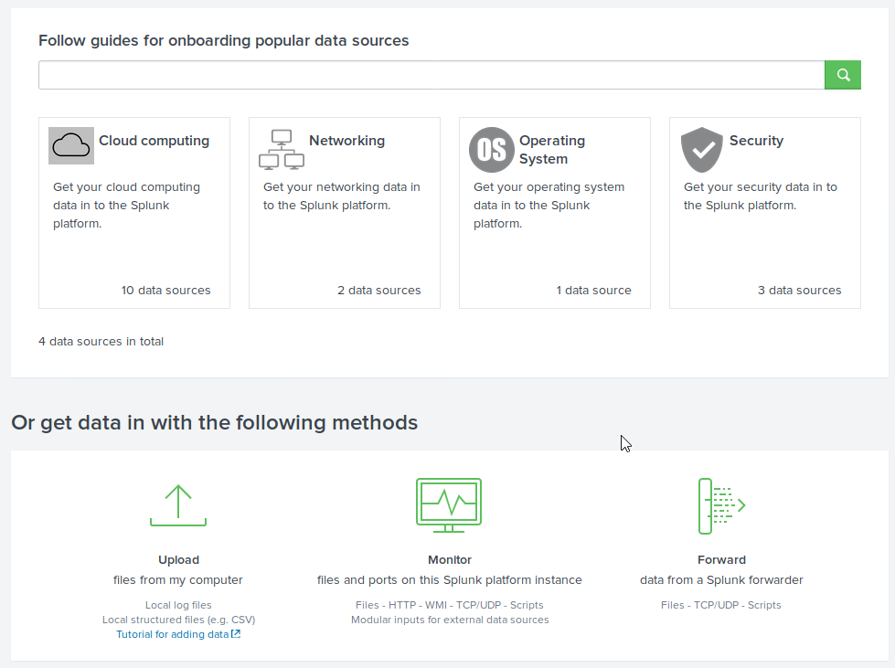
Splunk Data Addition Methods
The Add Data page prompts you to add data either by:
Data source
Specific method

Slide 36
Adding Data: Data Source
Adding data by data source lets us upload various types of data.
1
For example, a Splunk user may want to add Palo Alto Firewall logs into Splunk.
2
The Palo Alto option under Networking is an example of a data type.
3
Based on the option selected, an add-on may be provided or settings configured.

Slide 37
Adding Data: Specific Method
This feature let you add data by one of the following methods:
Monitor
Forward
Upload
Splunk monitors logs from a system, device, or application to which it has direct access.
Install a program called a forwarder on the system from which logs are collected.
Manually upload logs directly into your Splunk repository.
While monitoring
and forwarding are important to understand conceptually, we will primarily use the upload process for the rest of this lesson.
This method is commonly used by businesses to monitor their production environment.
Forwarders forward logs from a device into the Splunk system.

Slide 38
Uploading Data into Splunk
In this walk-through, we will use the following scenario to upload data into Splunk:
1
Your manager has reported some suspicious login activity on your Linux servers.
2
They have provided you with the login activity.
3
You must upload this activity data into Splunk so that it can be analyzed.

Slide 39
Data upload
‹#›

Slide 40
Uploading data into Splunk
In this activity, you will upload several log files that will be used
later to analyze security events.
15 minutes

Slide 41
‹#›

Slide 42
‹#›

Slide 43
‹#›
Notes:
Image source: AdobeStock_56885471
Break

Slide 44

Searching with Splunk

Slide 45

We will now focus
on Splunk’s most popular feature: Searching.
Notes:
shutterstock_145597207

Slide 46
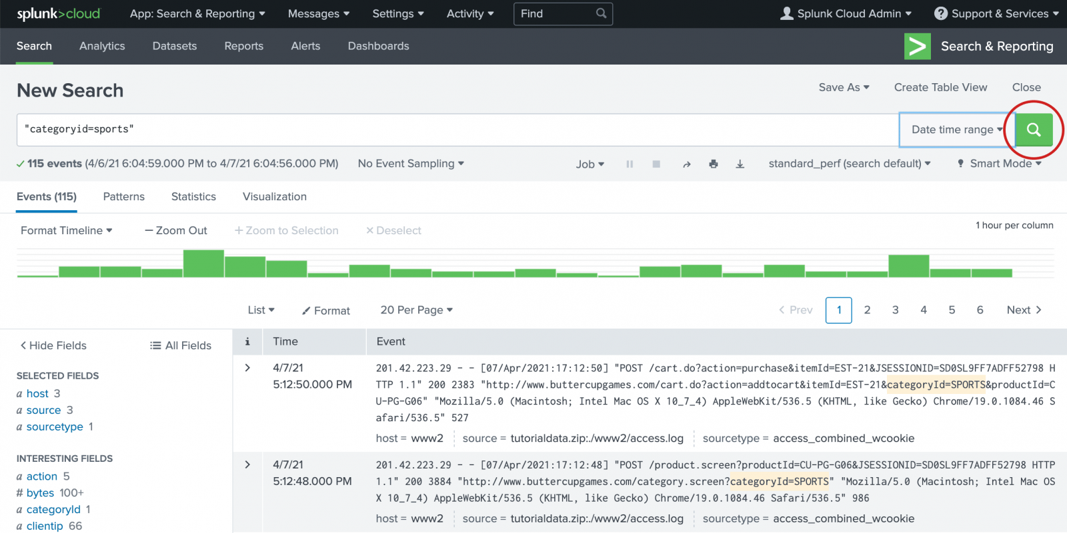
Searching with Splunk
Searching in Splunk allows users to query uploaded and monitored data.
Splunk queries
can be customized
to search only for specific data or to manipulate how the data is displayed.
Source: docs.splunk.com

Slide 47
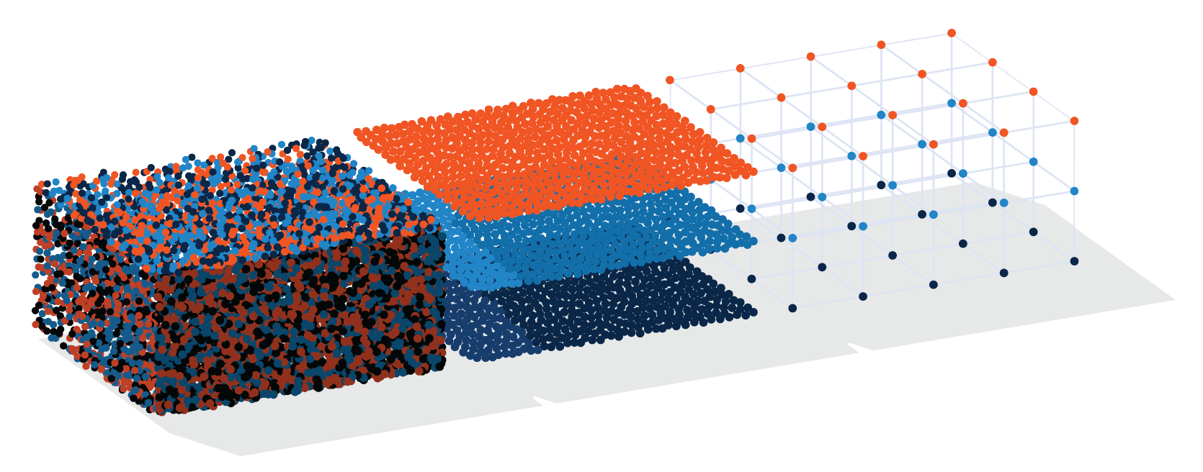
Searching in Splunk
We can use Splunk queries to find specific, helpful information about
a security event.
For example, we can use Splunk to:
Determine the primary IP that is being attacked during a DDoS attack.
Determine the user ID that is being used in a brute-force attack.
Notes:
Shutterstock_572923834 earth AdobeStock_96904257

Slide 48
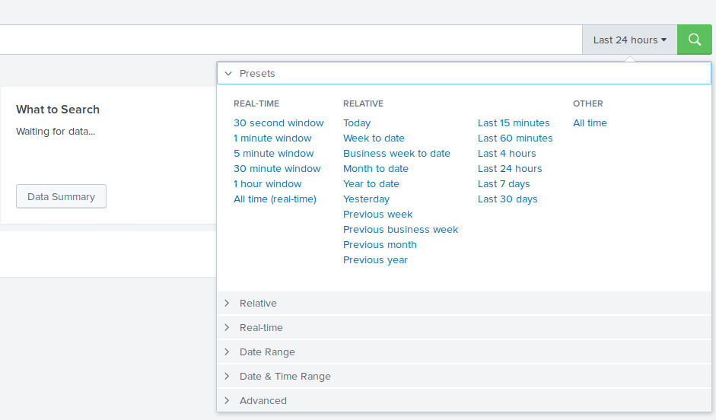
Searching in Splunk
Splunk searching is almost always a time-based search.
All events have
associated timestamps.
To search for events,
we must designate
a time range or
real-time period.

Slide 49
Searching in Splunk
A user can select the following:
Real-Time Search
Relative Search
All-Time Search
Returns a window
of real-time data as
it is happening and continues to update as the events occur.
Returns data by
date, date range,
time, or time range. Results will not change even if
more events occur.
Returns all available data based on the search.

Slide 50
Splunk queries are designed using a coding language called
Splunk processing language (SPL).
https://www.slideshare.net/Splunk/power-of-splunk-search-processing-language-spl

Slide 51
Key-Value Pairs
Using key-value pairs is the most common way to search for
data by matching keywords with specific information (values).
For example: If you want to find a user named jonathan in
your search results, you would design the following search:
user=jonathan
user
is the key
jonathan
is the value
user=jonathan
is the key-value pair

Slide 52
Wildcards
Similar to other programming languages, SPL uses wildcards. When used with the wildcard symbol (*), the search results return the search term followed by any character or string in place of the wildcard symbol.
For example:
user=mary* would return:
mary ann
user=mary*
mary beth
mary belle

Slide 53
Wildcards
Wildcards can also be used to find a value surrounded by any character.
For example:
user=*beth* would return:
mary beth
user=*beth*
bethanny
elizabeth

Slide 54
Boolean Expressions
SPL uses the Boolean expressions AND, OR, and NOT to assist
in searching for specific data.
Expression | Use | Example
AND | Combines two key-value searches | user=jonathan AND activity=login
OR | Looks for multiple instances of a key-value pair | user=jonathan OR user=beth
NOT | Excludes certain values from search results | user=jonathan NOT activity=logout

Slide 55
Search Demonstration
We will use the following scenario:
01
Your manager has reported some suspicious login activity on your Linux servers.
02
They would like you to write a query to look at these activities, specifically for logins coming from the source IP 10.11.36.17.
03
They believe this IP is from a machine infected with malware.
Note: src_ip is the field name for the source IP.

Slide 56
Searching
‹#›

Slide 57
SPL search
In this activity, you will design SPL searches to run against the
vulnerability-scanning log file nessus.txt.
15 minutes

Slide 58
‹#›

Slide 59
‹#›

Slide 60
Searching Fields with Splunk

Slide 61

Searching Fields with Splunk
So far we’ve manually typed out the keys and values for our SPL queries.
The more complex the
queries become, the
more time-consuming
this task will be.
Sometimes we don’t know the values or the format of the values that exist
in the search results.
Notes:
shutterstock_1728727282

Slide 62
Each server and application creates their own key and value names.

Slide 63
Complexities of SPL Queries
For example: If we need to find users that logged in to a machine:
The key might be:
The value might be:
Activity
Login
Event_type
Logon
User_activity
Logged In

Slide 64
Splunk fields
‹#›

Slide 65
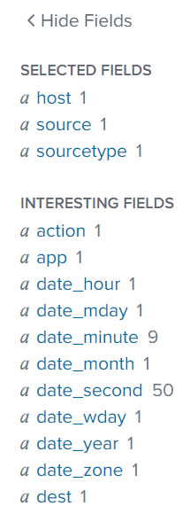
Search Fields
When files are uploaded and parsed, the data is separated into fields, as shown on the left side of Splunk’s search page.
Default Fields
Appear in every log event.
Interesting Fields
Appear in at least 20%
of the log events.
Value Count
A number on the right of each field indicating the count of different values for that field.

Slide 66
Creating queries by selecting fields
‹#›

Slide 67
Searching fields with Splunk
In this activity, you will create complex SPL queries by selecting fields
in your Splunk search.
15 minutes

Slide 68
‹#›

Slide 69
‹#›

Slide 70
Advanced Searches with Piping

Slide 71

SPL Piping
We can add piping to our SPL queries to modify or adjust the display of the results, or to create custom reports.
source="Linux_login.csv" host="Linux_Server__" sourcetype="csv" | head 20 | sort src_ip
SPL piping uses the | symbol in the search queries.
Piping works in Splunk
as it does in Linux:
the data is modified from left to right as it flows through the pipeline.

Slide 72
SPL piping
‹#›

Slide 73
Advanced searches with piping
In this activity, you will run several advanced searches to find
out whether a specific user is being targeted by an attacker.
10 minutes

Slide 74
‹#›

Slide 75
‹#›

